Slide 1
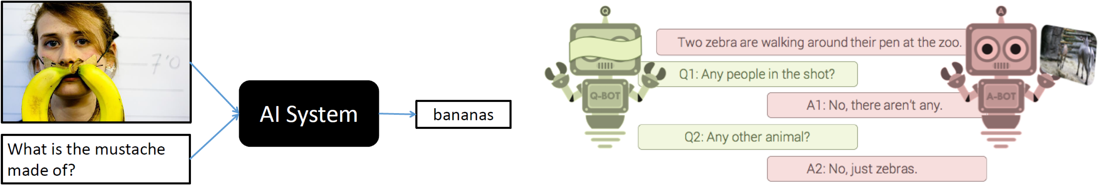



Closing Remarks

Slide 2












VQA sponsors
Army Research Office
Army Research Lab
National Science Foundation
Office of Naval Research

Slide 3
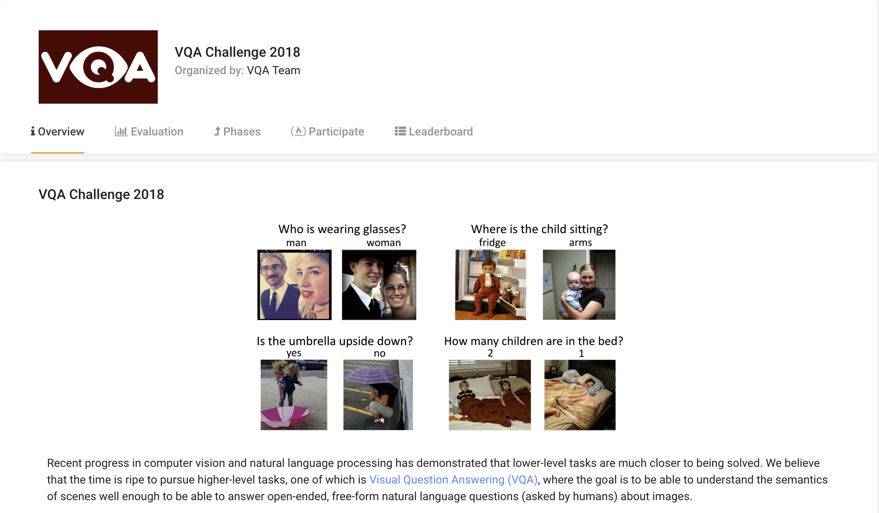
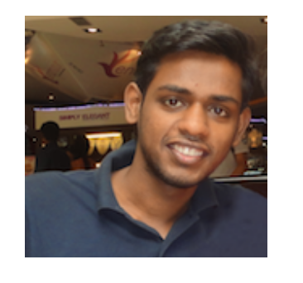
Challenge host: EvalAI
Open source platform that helps researchers to create, collaborate and participate in various AI challenges
Deshraj Yadav
https://evalai.cloudcv.org/

Slide 4
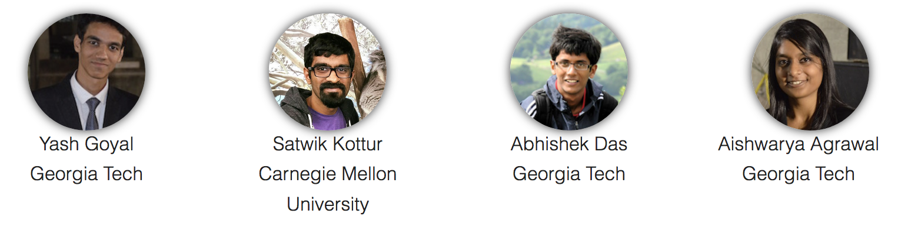

Co-organizers

Slide 5
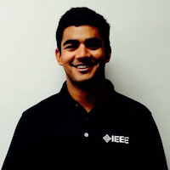
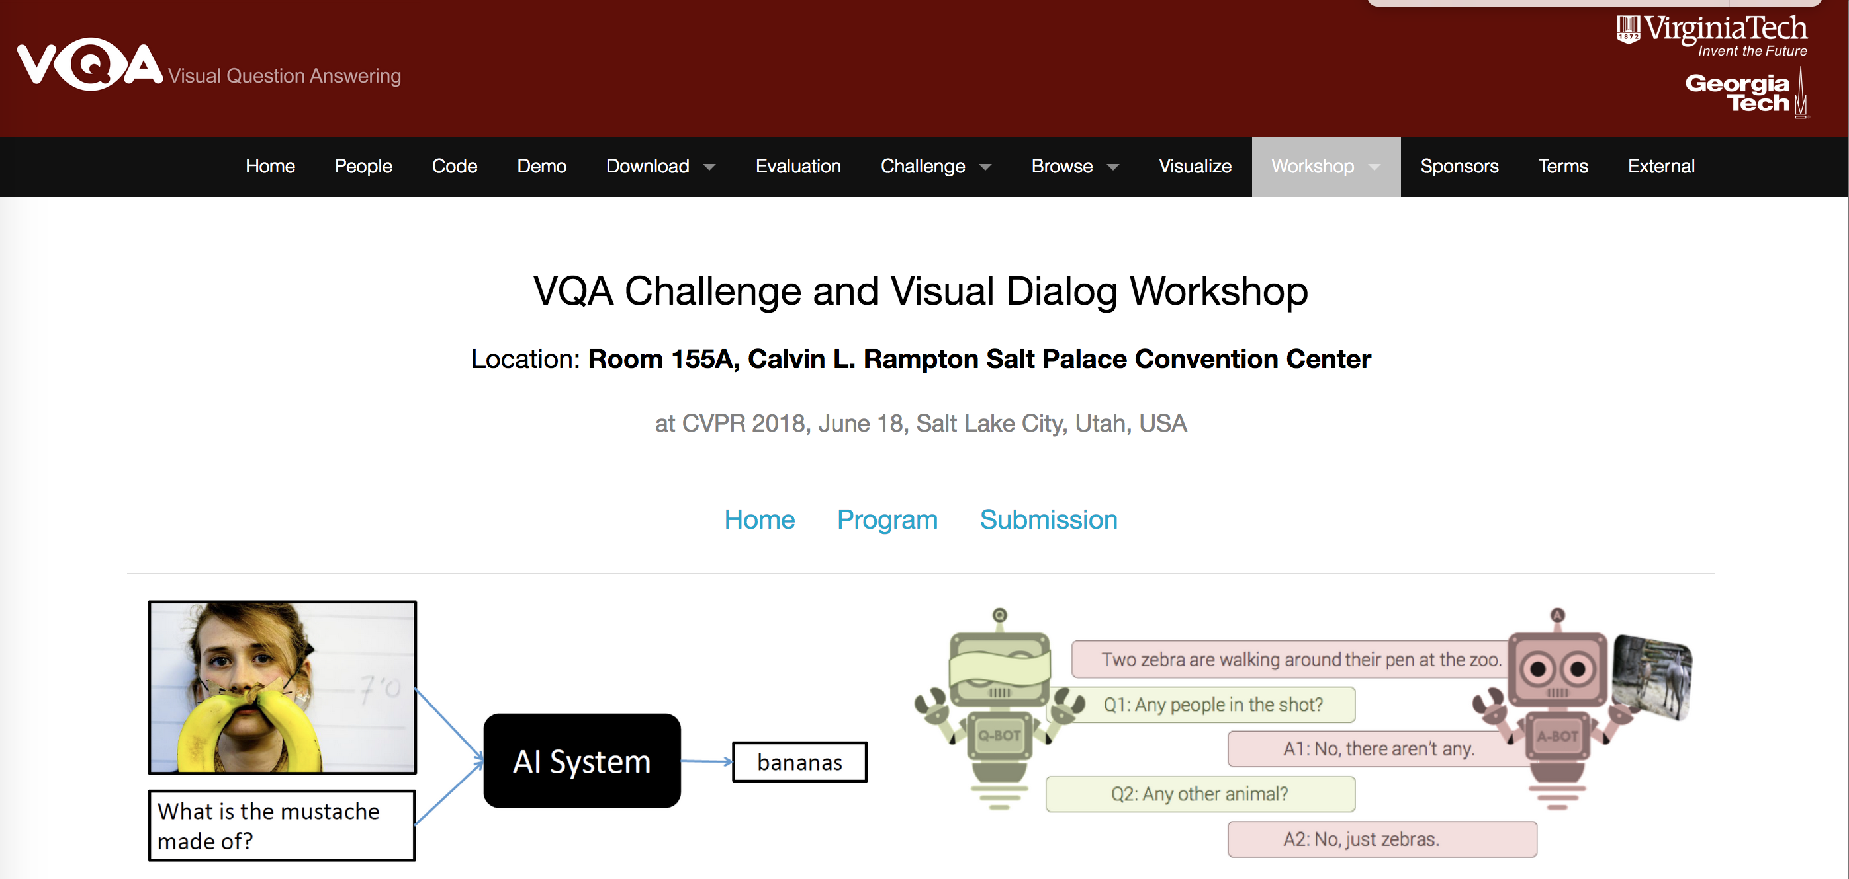
Webmaster
Akrit Mohapatra

Slide 6

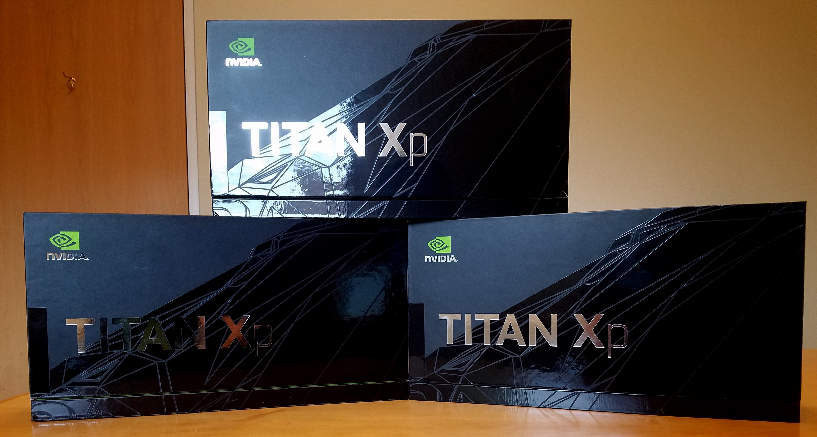
GPUs
Stefan Lee

Slide 7
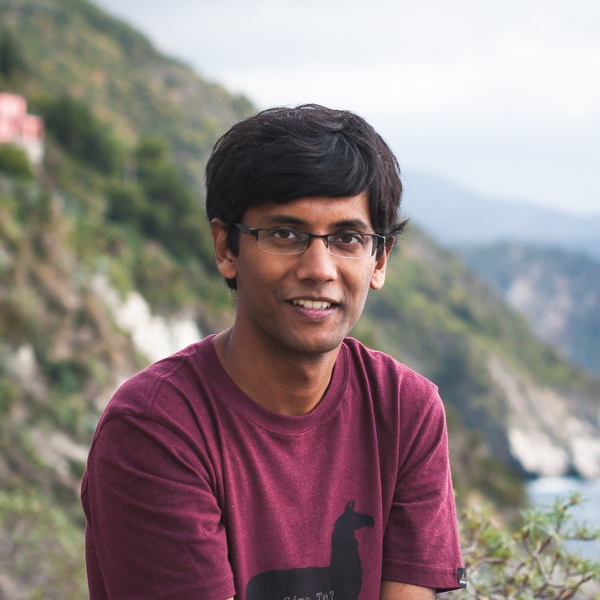
This time we have mugs…
Abhishek Das

Slide 8
We got a little carried away…
Abhishek Das

Slide 9
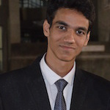
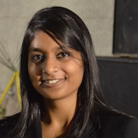
Student lead-organizers
Yash Goyal
Aishwarya Agrawal

Slide 10
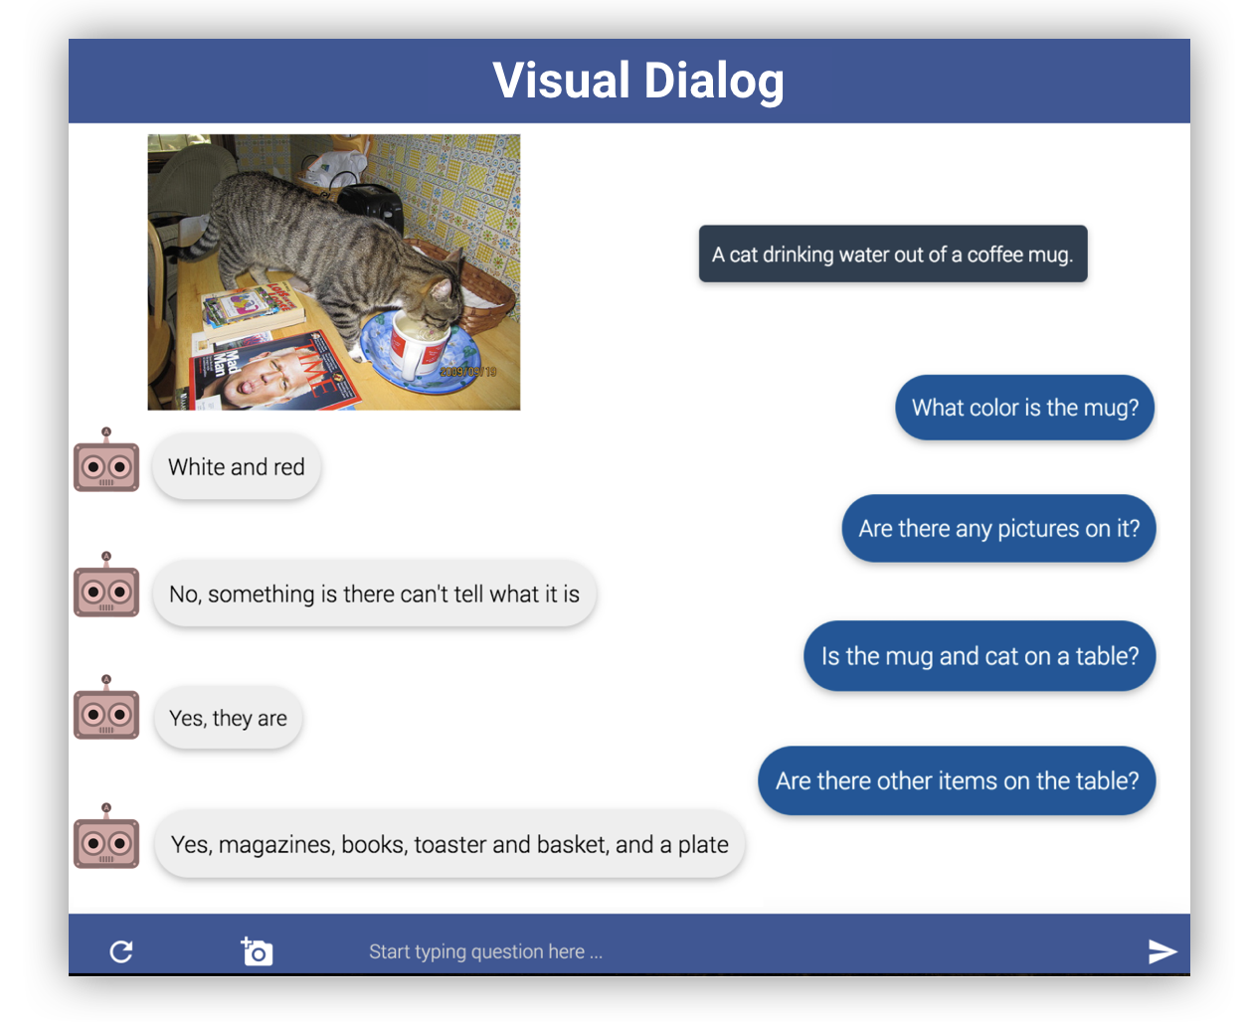
Visual Dialog Challenge 2018
VisDial v1.0
~130k images (COCO)
10-round dialog / image
~1.3 million QA pairs
Evaluation
Automatic metrics
Human annotations
Deadline: mid-August, 2018
Results: September 8th, 2018 at ECCV 2018
visualdialog.org/challenge/2018

Slide 11
Thoughts are very welcome.

Slide 12
Happy CVPR-ing!

